Slide 1

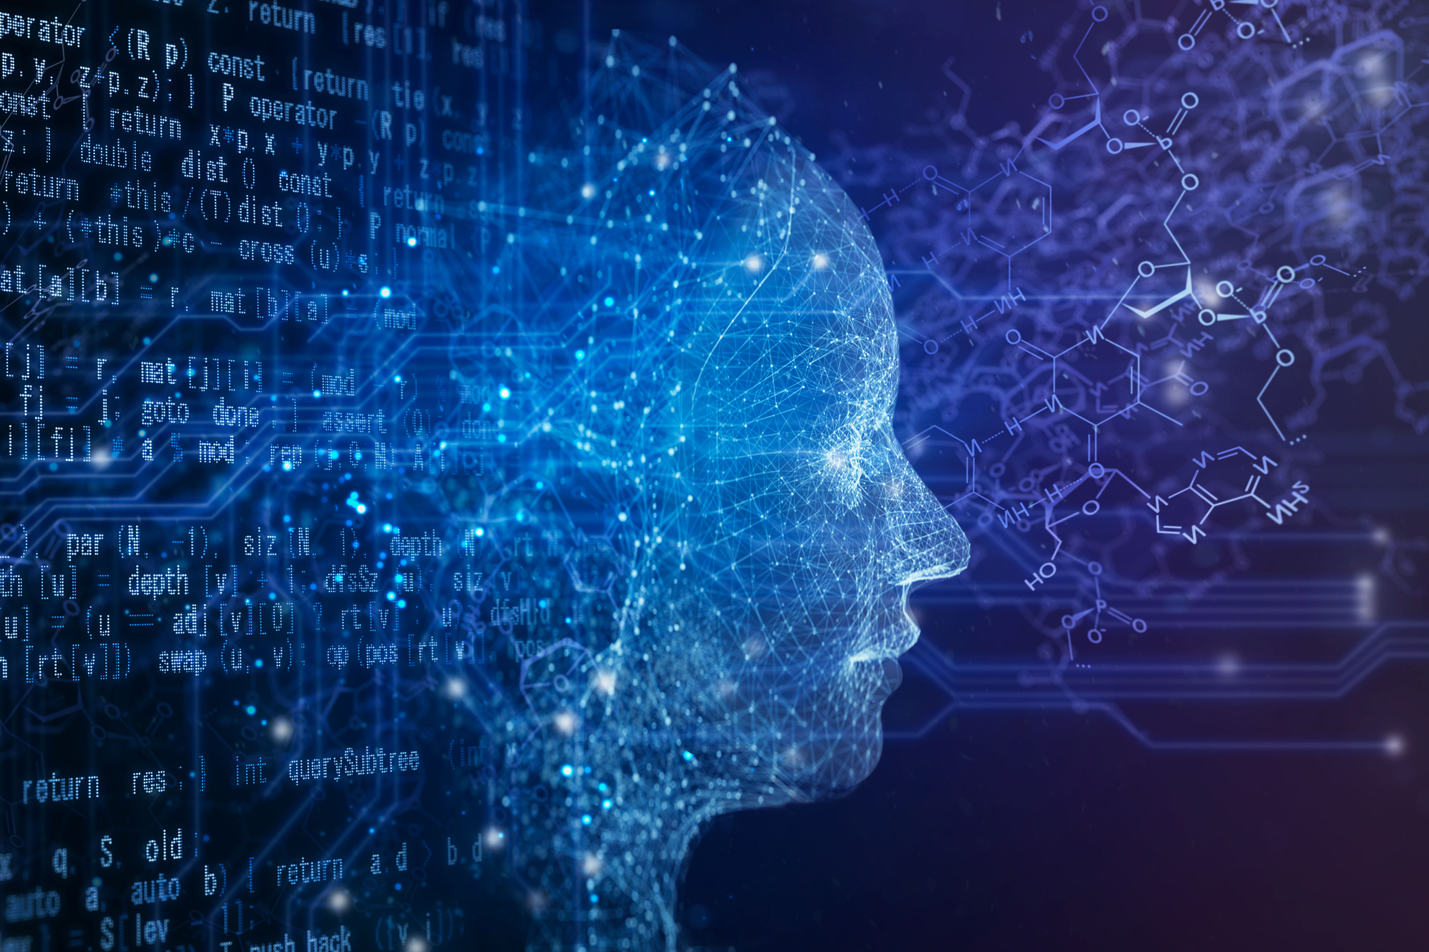


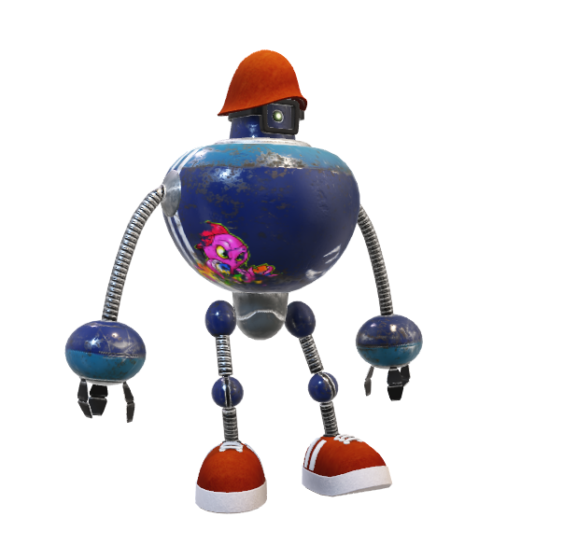
AI DRIVEN SENTIMENT ANALYSIS

Slide 2






the team
ARUNANGSHU NAG
11900121026
ABHIRUP BASU
11900121033
DIGANTA DAS
11900121014
SUBARNA GHOSH
11900121036
TRIDIB TALUKDAR
11900121001
ANIRUDHA GUPTA
11900121021

Slide 3

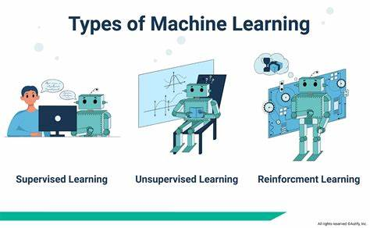
Machine learning
Machine Learning is the field of study that gives computers the capability to learn without being explicitly programmed. ML is one of the most exciting technologies that one would have ever come across. As it is evident from the name, it gives the computer that makes it more similar to humans: The ability to learn. Machine learning is actively being used today, perhaps in many more places than one would expect.
TYPES OF MACHINE LEARNING:
SUPERVISED MACHINE LEARNING
UNSUPERVISED MACHINE LEARNING
SEMI-SUPERVISED MACHINE LEARNING

Slide 4
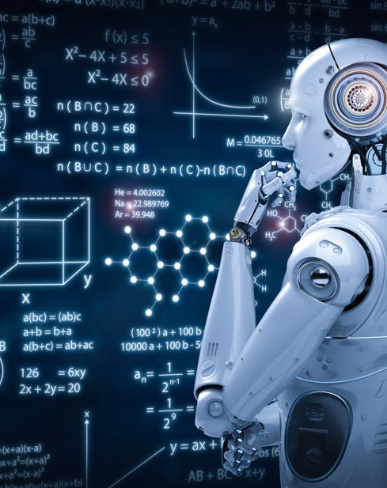
introduction
Ai driven sentiment analysis or opinion mining is the computational study of people’s opinions, sentiments, attitudes, and emotions expressed in written language. It is one of the most active research areas in natural language processing and text mining in recent years. In this project, our main motive is to create a python program that will detect emotion of a sentence/text and human face. This might be interesting if you want to do things like emotion detection using python, or if you’re training machine learning systems to read human emotions. We’re going to create programs that takes an image/text as an input and a list of human emotions that the image/text invokes. To do this, we’re going to use TensorFlow and other required libraries. Our main motive is to use this project to detect the sentiment analysis to text as well as human face. This project will help to analyze the emotions of a person in the web.

Slide 5

PROBLEM STATEMENT
SOLUTION APPROACH
CHALLENGES
AI driven Sentiment analysis or opinion mining is the computational study of people’s opinions, sentiments, attitudes, and emotions expressed in written language.
➢ What is text emotion prediction?
➢ What will be the face emotion recognition?
➢ Using proper dataset
➢ Getting accurate prediction
➢ Need of high configuration machines for more accurate detection.
➢ Lack of proper datasets
➢ Short time duration for completion
➢ Requirement of high configuration machines
➢ Proper output from a small dataset.
➢ Searched and created proper datasets for proper functioning of the program with the machines
➢ Good team cooperation.
➢ Using proper data to get accurate outputs.

Slide 6
LIBRARIES
PANDAS: This library helps to load the data frame in a 2D array format and has multiple functions to perform analysis tasks in one go.
NUMPY: NumPy arrays are very fast and can perform large computations in a very short time.
TENSORFLOW: TensorFlow is a Python library for fast numerical computing created and released by Google. It is a foundation library that can be used to create Deep Learning models directly or by using wrapper libraries that simplify the process built on top of TensorFlow.
SCIKIT-LEARN: It is a Python library is associated with NumPy and SciPy. It is considered as one of the best libraries for working with complex data.
KERAS: Keras is considered as one of the coolest machine learning libraries in Python. It provides an easier mechanism to express neural networks. Keras also provides some of the best utilities for compiling models, processing data-sets, visualization of graphs, and much more.
MATPLOTLIB : Matplotlib is a comprehensive library for creating static, animated, and interactive visualizations in Python.
SEABORN: seaborn is a python data visualization library based on matplotlib. It provides a high-level interface for drawing attractive and informative statistical graphics.
OPEN-CV: OpenCV-Python is a library of Python bindings designed to solve computer vision problems. Python is a general purpose programming language started by Guido van Rossum that became very popular very quickly, mainly because of its simplicity and code readability.
RANDOM: The Python Random module is a built-in module for generating random integers in Python.
6

Slide 7

DATASETS
The data we have used in this project was in .Txt and images files.
It was taken from kaggle.Com/fer2013 .
The Text dataset consists of 15999 rows and 2 columns with no null values.
The face emotion dataset consists of 3000 images of different emotions categorized in different classes.
Other operations of datasets are also confirmed
7

Slide 8
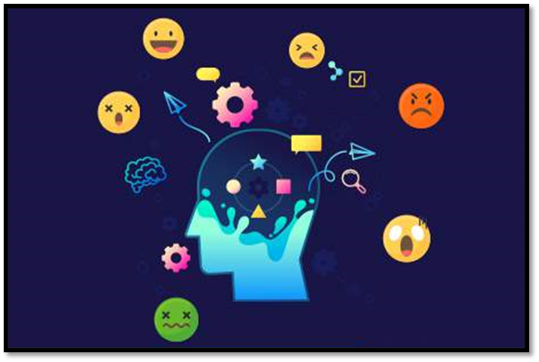
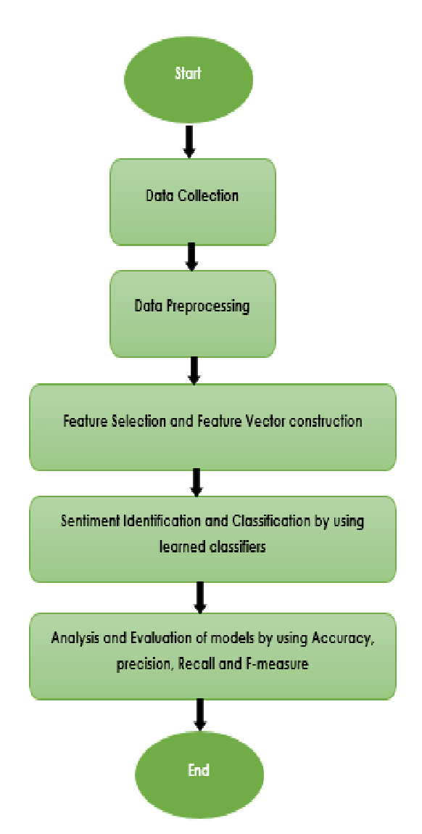
TEXT EMOTION PREDICTION
In machine learning, the detection of textual emotions is the problem of content-based classification, which is the task of natural language processing. Detecting a person’s emotions is a difficult task, but detecting the emotions using text written by a person is even more difficult as a human can express his emotions in any form.
Usually, emotions are expressed as joy, sadness, anger, surprise, hate, fear, etc. Recognizing this type of emotion from a text written by a person plays an important role in applications such as chatbots, customer support forum, customer reviews etc. For text emotion prediction analysis, we are using python and its other required libraries which will complete the prediction. Our objective is to predict the correct emotion of a desired input text.

Slide 9
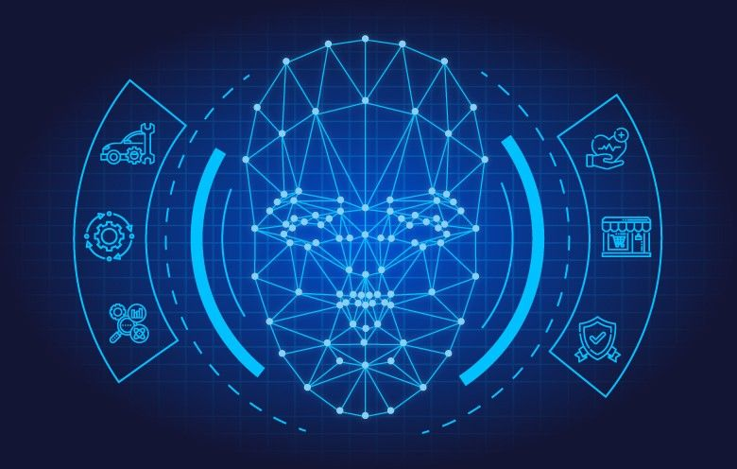
MODEL
A model is a python class that inherits from the model class. The model class defines a new kind of datastore entity and the properties the kind is expected to take. Here we are training the model with epoch=100. And subsequently our model is saved as “hlo.h5”.
PLOTTING THE GRAPH OF LOSS AND ACCURACY

Slide 10
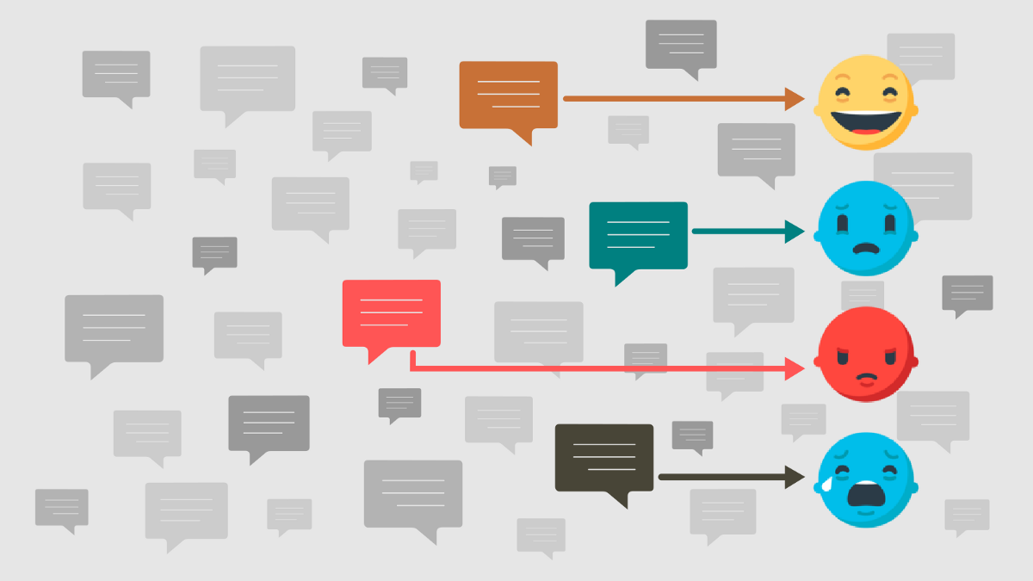
PROCESSING AN INPUT TEXT
In this part we have entered a desired text and then by processing the input text by the train model and hence we receive the subsequent output.
Input text: “I lost my pen”
Original output should be sad and predicted output is also sadness.

Slide 11
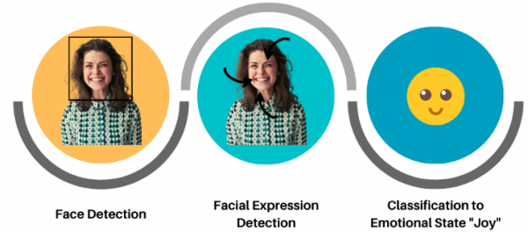
FACE EMOTION RECOGNITION
Facial expression emotion recognition is an intuitive reflection of a person’s mental state, which contains rich emotional information, and is one of the most important forms of interpersonal communication. It can be used in various fields, including psychology. Face emotion recognition is that with the help of imported libraries and other application we have created a program which can detect the emotion of a real time live face through webcam access.
HOW FACE EMOTION RECOGNITION WORKS
1. Face detection
2. Facial analysis
3. Facial recognition
4. Emotion analytics
USES OF THIS RECOGNITION:
Healthcare
Product testing and client feedback
Enhances customer service
Assess personality traits in interviews

Slide 12
MODEL
Keras Applications are deep learning models that are made available alongside pre-trained weights. These models can be used for prediction, feature extraction, and fine-tuning. Now we’ll use MobileNetV2.
WORKING OF DENSE LAYERS OF THE MODEL:
The dense layer is a neural network layer that is connected deeply, which means each neuron in the dense layer receives input from all neurons of its previous layer. The activation function is a mathematical “gate” in between the input feeding the current neuron and its output going to the next layer. It can be as simple as a step function that turns the neuron output on and off, depending on a rule or threshold. Here we’re using relu as activation function.
CREATING THE NEW MODEL AND COMPILING IT:

Slide 13
PREDICTING THE EMOTION OF AN IMAGE
HERE WE ARE INSERTING A IMAGE AND PREDICTING THE IMAGE EMOTION THROUGH OUR TRAINED MODEL. BELOW ARE SOME SNIPETS:
As we can see the predicted class is 4 therefore, we know 4 refers to neutral images so it predicted a correct emotion.

Slide 14

OBSERVATIONS
Firstly, we have learned about many important libraries
Worked with different datasets
We created models for both the programs
Plotting graphs
Detected the emotions through text and face

Slide 15

FUTURE ASPECTS
Our main future aspect is to bring more accurate predictions from the detections from a proper amount of data.
In future, from the text emotion we want to develop it to more advanced learning that it can detect an emotion from a chat, tweet, documents, other social media in the web just by scanning .
In future, from the face emotion recognition we want to develop it more advanced learning that it can detect face mask detection, emotions through a video call, etc.
Another aspect is to work on this project and build a model that can join both the programs into a single project and develop a better user interface.

Slide 16
RESULTS OF THE PROJECT
Project name : AI DRIVEN SENTIMENT ANALYSIS
DETECTED PROPER EMOTION FROM TEXT AND FACE
CONTRIBUTIONS:
ARUNANGSHU NAG ----->TEXT EMOTION PREDICTION, DOCUMENTATION, PPT MAKING
DIGANTA DAS -----> FACE EMOTION RECOGNITION, DOCUMENTATION
SUBARNA GHOSH -----> FACE EMOTION RECOGNITION, DOCUMENTATION
ABHIRUP BASU -----> PPT MAKING, COLLECTING RESOURCES
TRIDIB TALUKDAR -----> PPT PRESENTATION
ANIRUDHA GUPTA -----> PPT MAKING, PRESENTATION
Github link:

Slide 17
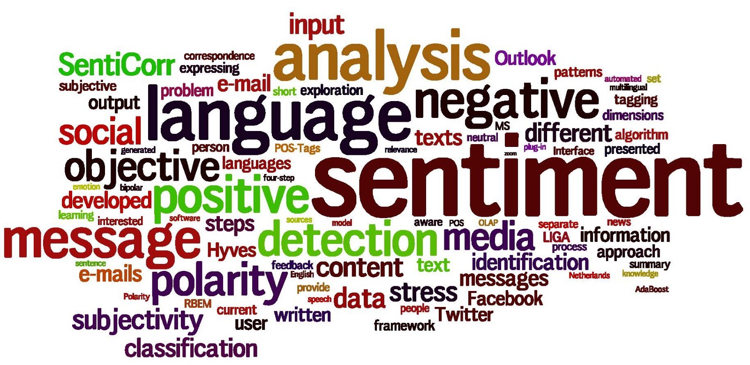
CONCLUSION
AS THE PROJECT HAS TWO PARTS: TEXT DETECTION AND FACE EMOTION DETECTION WE FACED MANY CHALLENGES TO PREDICT THE CORRECT RESULT. AS FOR DETETCTION OF AN IMAGE/FACE WE HAD A VERY BIG DATASET, WHICH REQUIRED HIGH CONFIGURATION MACHINES SO WE HAD TO REDUCE OUR DATASET. SUBSEQUENTLY THE ACCURACY WAS NOT ACHIEVED AND HENCE HAD TO FACE A LOT OF CHALLENGES FOR IT. BUT AFTER TRAINING THE MODELS PROPERLY OUR TEXT EMOTION DETECTION IS WORKING APPROX 80% CORRECT EMOTION DETECTION AND AS WE HAVE A VERY SMALL DATASET OF IMAGES SO WE HAVE ACHIEVED 60% APPROX ACCURACY FOR THE MODEL TO DETECT THE EMOTION. THIS PROJECT WILL HELP US TO DETECT THE SENTIMENT OF SOMEONE IN THE WEB (SOCIAL MEDIA) THROUGH TEXT AND IN FUTURE THE FACE DETECTION WILL HELP TO REVEAL INFORMATION ON ONE'S EMOTIONAL STATE.

Slide 18


